Slide 1
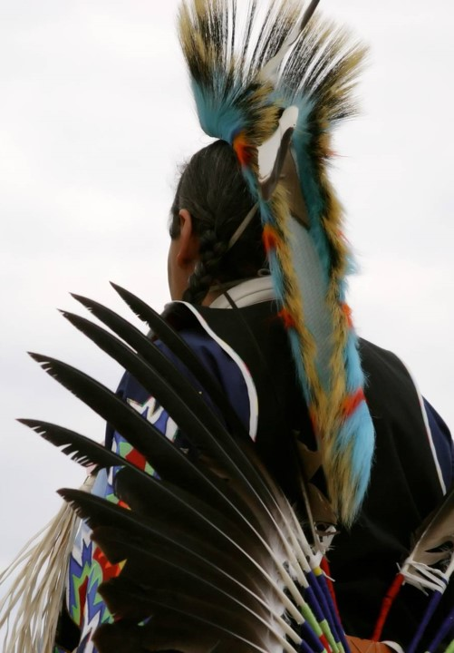
INSTAGRAM ANALYSIS
~ Abhishek Koundal

Slide 2

AGENDA :
Problem Statement
Data Description
Objective Key Metrics and Visualizations
Subjective Question for Insights

Slide 3

INTRODUCTION
Instagram was launched in October 2010 by Kevin Systrom and Mike Krieger as a photo-sharing app focused on simplicity and creativity. Initially designed to enhance mobile photos with filters, it quickly grew in popularity. By 2012, Facebook acquired Instagram, expanding its reach and adding new features like Stories, Explore, and Reels, transforming it into a global social media powerhouse.

Slide 4
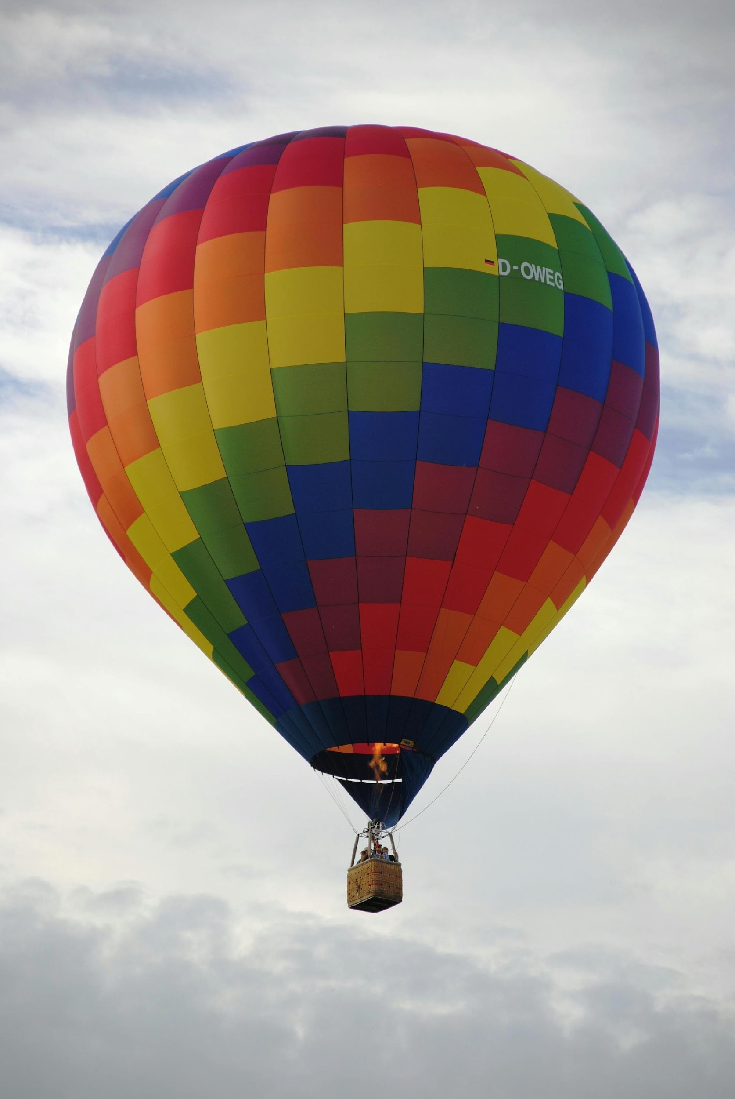
PROBLEM STATEMENT
You are hired as a data analyst at Meta and asked to collaborate with Marketing team. Marketing teams wants to leverage Instagram's user data to develop targeted marketing strategies that will increase user engagement, retention, and acquisition. Provide insights and recommendations to address the following objectives.

Slide 5

CONTENT IS FIRE, SOCIAL MEDIA IS GASOLINE
~ Jay Baer

Slide 6
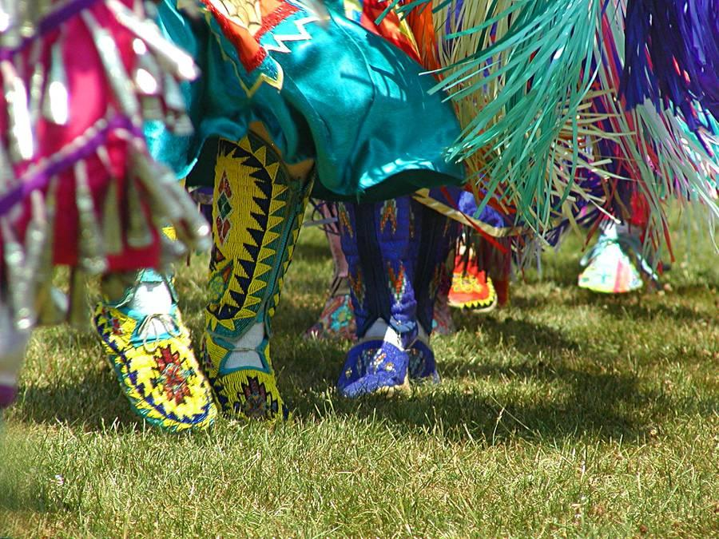



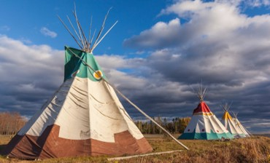

DATA OVERVIEW

Slide 7
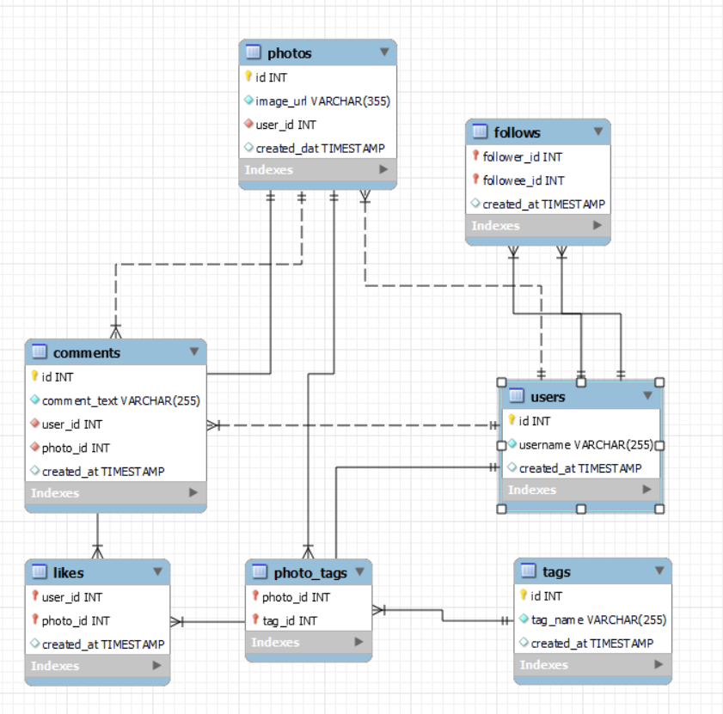
DATABASE SCHEMA

Slide 8
DATA DESCRIPTION
About columns
User Data
comments_id : unique identifier for each comment
comment_text : text content of a given comment
user_id : unique identifier for each user
photo_id : unique identifier for each photo
created_at : date of interaction in the form like, photos, tags
follower_id : user_id of the follower for a certain user
followee_id : user_id of followee for a certain user
tag_id : unique identifier for each tag
image_url : link to the image posted on the platform.
username : username chosen by the user
Data from 100 user’s are available.
There is 8 inactive user in the data and 92 active users.
The information available pertains solely to the content type “photos” only.

Slide 9
DATA CLEANING
Identify and Remove Duplicates: Use queries like DISTINCT, ROW_NUMBER(), or DELETE with JOIN to find and remove duplicate rows.
Handle Missing Values: Replace missing values using functions like COALESCE() or IFNULL(), or filter out rows with missing values using WHERE clauses.
Standardize Data: Ensure uniformity in formats (e.g., date formats) and naming conventions (e.g., uppercase or lowercase) with UPPER(), LOWER(), TRIM(), and CAST().
Correct Inaccurate Data: Use UPDATE statements to correct data based on predefined rules or reference tables.
Filter Outliers and Irrelevant Data: Exclude outliers or irrelevant data using conditions in WHERE clauses or CASE statements to categorize data accurately.
Validate and Enforce Constraints: Add constraints (e.g., NOT NULL, UNIQUE) to prevent future inconsistencies.

Slide 10
METHODOLOGY USED
Data Modeling: Creating an efficient database schema with normalized tables to reduce redundancy. Common techniques include ER (Entity-Relationship) modeling, normalization (up to 3NF or beyond), and indexing.
Data Retrieval: Using SELECT statements with joins (INNER, LEFT, RIGHT, FULL OUTER), subqueries, and set operations (UNION, INTERSECT, EXCEPT) to pull and analyze data.
Data Manipulation: Leveraging INSERT, UPDATE, DELETE, and MERGE statements to add, modify, or remove data records.
Data Cleaning: Implementing steps to identify duplicates, handle NULLs, standardize formats, and correct inaccurate data using SQL functions (e.g., COALESCE, TRIM, UPPER).
Data Aggregation: Utilizing functions like SUM, COUNT, AVG, MIN, MAX and grouping data with GROUP BY to derive insights.
Data Integrity and Validation: Enforcing rules with constraints (PRIMARY KEY, FOREIGN KEY, UNIQUE, CHECK) and triggers to ensure data accuracy and consistency.

Slide 11
DATA ANALYSIS

Slide 12
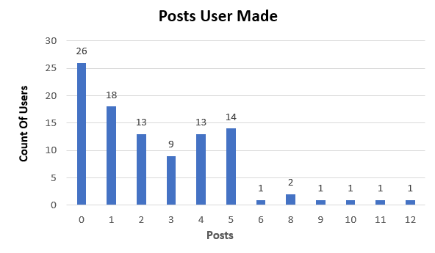
NUMBER OF POSTS MADE BY USERS
Most users post 0-5 times, indicating infrequent posting.
Users may engage more as viewers or commenters, not as active posters.
Minimal activity suggests potential to increase posting gradually.
Focus on 0-5 post users with prompts or incentives to encourage more posts.

Slide 13
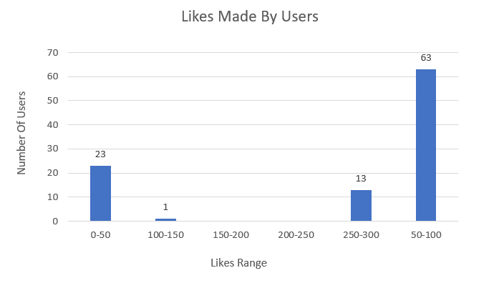
LIKES MADE BY USERS
Most users are in the 50-100 likes range, indicating moderate activity.
A notable number of users (23) fall in the 0-50 likes range, showing lower engagement.
Only 13 users are in the 250-300 likes range, representing high engagement.
Very few users (1) are in the 100-150 range, suggesting an unusual engagement distribution.
Increasing activity among the 0-50 likes group could enhance overall platform engagement.

Slide 14
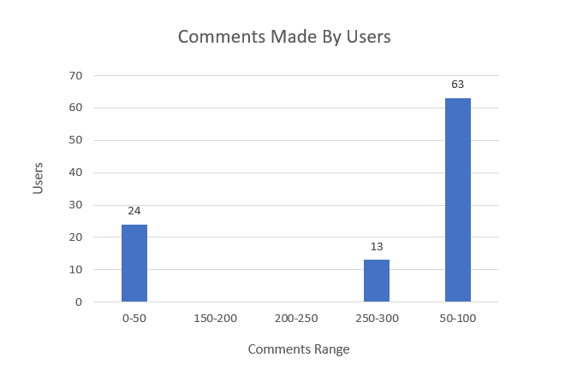
COMMENTS MADE BY USERS
Most users (63) fall within the 50-100 comments range, indicating that the majority are moderately active on the platform.
A smaller group (24 users) has made between 0-50 comments, suggesting a portion of the user base is less active.
A very small number of users (13) are in the 250-300 comments range, showing extremely high engagement among a limited subset.
No users are in the 100-150 or 150-200 comment ranges, highlighting an absence of mid-level activity.
Focusing on encouraging more engagement from the low-activity users in the 0-50 range could enhance overall platform interaction.

Slide 15

RECOMMENDATIONS
Encourage Posting: Add prompts, challenges, or content ideas to boost posting frequency, especially among users active in likes and comments.
Incentivize Low-Engagement Users: Target users in the 0-50 range (posts, likes, comments) with rewards or badges to increase their activity.
Boost Mid-Level Engagement: Address the 100-150 and 150-200 activity gaps with personalized campaigns to transition low-engagement users.
Leverage Highly Active Users: Encourage users in the 250-300 range (likes, comments) to post and engage as community leaders.
Diversify Interactions: Introduce low-effort features (polls, stories) to attract users with different engagement preferences.
Monitor Trends: Track engagement patterns regularly to adjust incentives and maintain a dynamic user community.

Slide 16
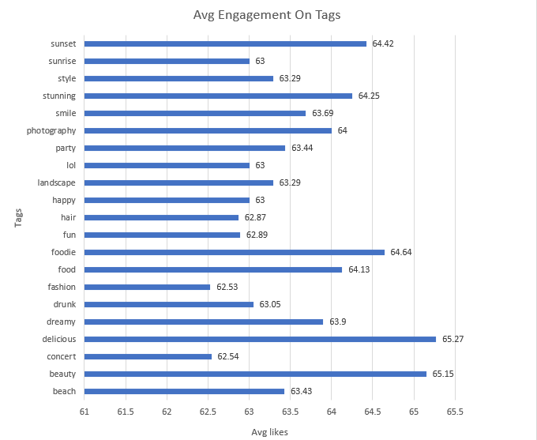
USERS INTEREST ON DIFFERENT CONTENT TYPE
Engagement in Food Content: High engagement in food-related hashtags suggests a vibrant community around culinary experiences.
Visual Appeal is Key: Aesthetic visuals, particularly of nature and beauty, are crucial for driving audience interaction.
Emotional Connection: Content that elicits positive feelings or fun experiences fosters stronger connections with the audience.
Lifestyle Relevance: Fashion and lifestyle topics continue to be relevant, presenting avenues for engagement with lifestyle brands.
Social Events Matter: While social and humorous content is engaging, it ranks lower compared to the other categories, indicating room for growth in this area.

Slide 17

RECOMMENDATIONS
Highlight Food Content: Share visually appealing food posts, recipes, and restaurant highlights using hashtags like #delicious and #foodie.
Prioritize Visuals: Use high-quality photography of nature and sunsets; incorporate hashtags like #sunset and #photography to attract aesthetic-focused audiences.
Evoke Positive Emotions: Create fun and engaging content, such as party highlights and feel-good stories, using hashtags like #smile and #happy.
Share Lifestyle and Fashion: Post lifestyle tips and fashion inspiration, leveraging hashtags like #style and #fashion to engage enthusiasts.
Feature Social Events: Highlight concerts and social moments with hashtags like #concert and #lol to connect with entertainment-seeking users.
Mix Content Types: Combine different themes (food, lifestyle, emotional) in posts to appeal to diverse audience segments while using trending hashtags.

Slide 18
STRATEGIES
Partner with influencers in your niche to reach their audience. Provide them with unique content or products to showcase, increasing your brand’s visibility and credibility.
Create valuable and relevant content that resonates with your target audience. Utilize blogs, videos, and social media posts to attract and inform potential users about your offerings.
Offer rewards for engaging with your content, such as points for comments, shares, or participation in discussions. These points can be redeemed for discounts, products, or exclusive content.
Incorporate interactive elements like polls, quizzes, or surveys in your content to encourage user participation. This increases engagement and provides valuable feedback.
Use social media and online advertising to target specific demographics that align with your user base. Use eye-catching visuals and compelling calls-to-action to attract attention.

Slide 19
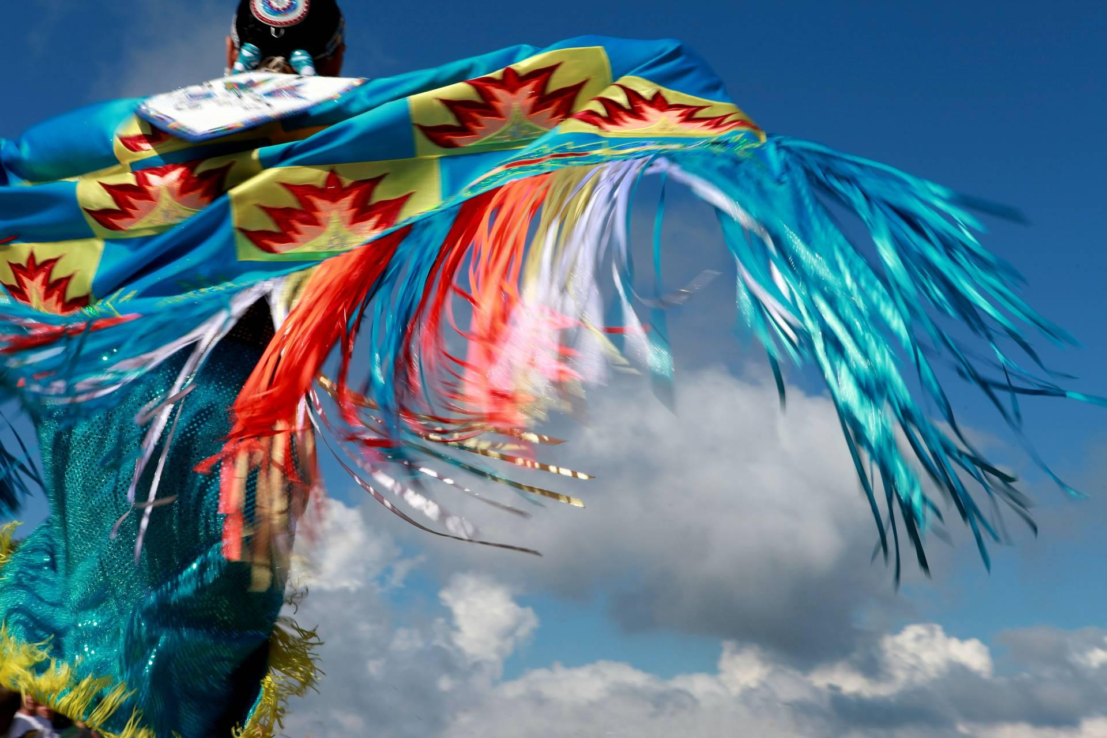
SUMMARY
By combining strategies to attract new users with engaging techniques, you can create a dynamic environment that fosters user growth and enhances overall satisfaction. Focusing on community-building and personalized experiences will help in retaining users and encouraging them to engage more deeply with your brand.

Slide 20


THE END
WRAP UP THE TRIP INTO HISTORY AND ADD YOUR FINAL THOUGHTS, IDEAS, AND QUESTIONS.

